Slide 1
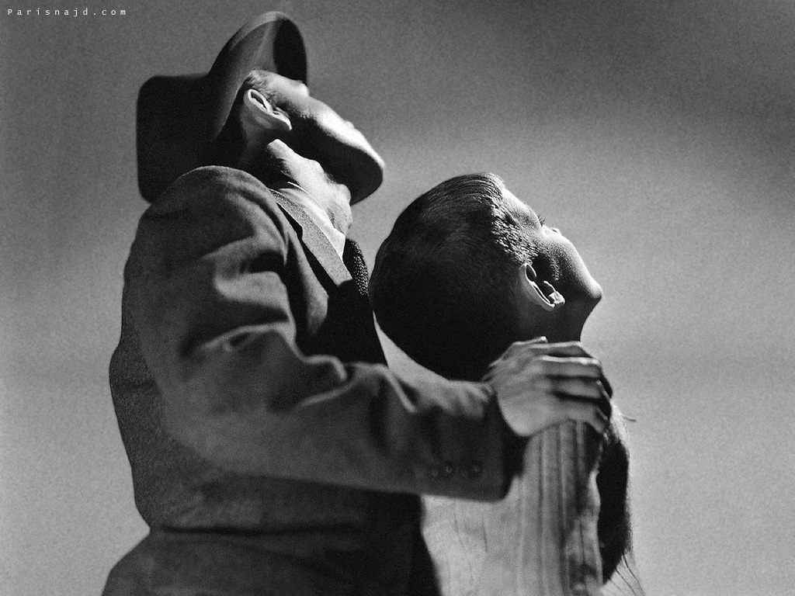
The Sound and the Fury Theme

Slide 2

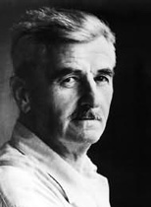
The Sound and the Fury Theme of Innocence
In this novel, innocence comes in strange forms.
There’s the mother who preaches a sort of rigid withdrawal from life, a son whose attempts to speak result in forced castration, and a son so obsessed with innocence that he kills himself to stop thinking about it. As Mr. Compson says, innocence can only be recognized once it’s been lost. That doesn’t mean, however, that people won’t chase the ideal it represents forever. No coming of age story is complete without a loss of innocence; in The Sound and the Fury, we have loss upon loss upon loss.

Slide 3

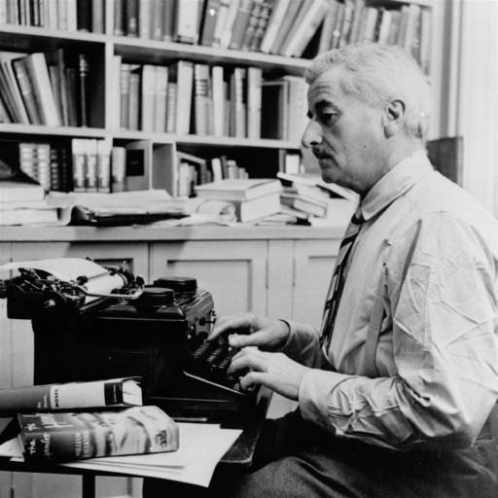
The Sound and the Fury Theme of Sin
For the characters of The Sound and the Fury, sin is almost always related to sex. In fact, at times the two are synonymous. A daughter’s blossoming sexuality becomes the tipping point which throws an entire family into chaos.

Slide 4

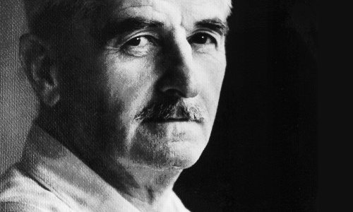
Even though sex is at the center of the novel, it’s something that the characters can’t address fully. If they admit that someone has moved beyond the morals preached by older generations, then they’re left navigating unknown territory – something which moves one brother to madness and another to all-consuming rage. Sin, we learn, is a relative term – one that changes according to the shifting perspectives of individual characters

Slide 5

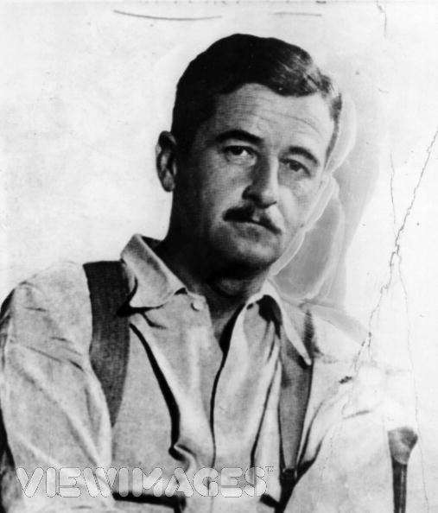
Murry's behavior took its toll on Faulkner's mother, Maud, an independent, hardheaded woman, and his parents fought often.
The Falkner family moved to Oxford, Mississippi, where Murry took a job running a livery.
In Oxford, the Falkners hired an African-American live-in nanny, Caroline Barr, to help raise Billy and his three younger brothers. Known to the boys as "Mammy Callie,"

Slide 6

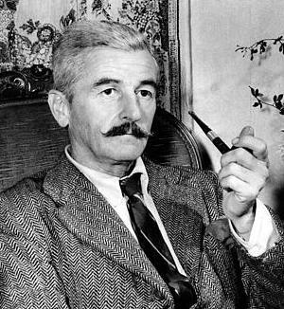
The Sound and the Fury Theme of Home
Ah, home sweet home. A falling-apart house in a small Mississippi town becomes the center of this novel. As we see, however, even the land the house stands on is disintegrating: pasture land is sold to buy a college education. More than the Compson house, however, this is also a novel about the South.

Slide 7

Heck, maybe it’s even THE novel about the South. Rife with the smells, sounds, and sights of rural Mississippi, The Sound and the Fury creates a world that hovers between the history of the Civil War and the present (that’s the 1930s, in case you were wondering).

Slide 8

The Sound and the Fury Theme of Memory and the Past.
For the characters in The Sound and the Fury, memories of the past dominate the present day. Revolving around Caddy, the runaway daughter of the family, the novel works (and re-works and re-works) the consequences of her disappearance from her brothers’ lives. Everything important happened Before.

Slide 9

Before what? Well, before the time of narration. Also before characters have a chance to figure out what response they should have. Focusing on the past, characters let the present moment slide by – and only later do they realize how much of their lives they’ve lost.

Slide 10

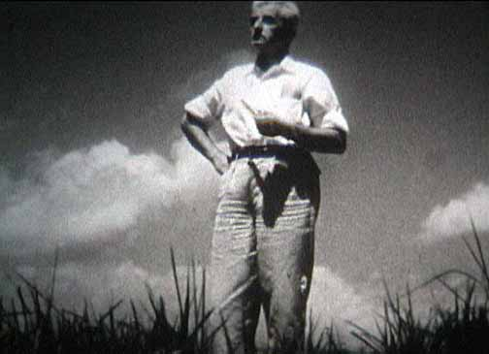
The Sound and the Fury Theme of Family
This is a novel about family – but more than that, it’s about a family in a freefall. An alcoholic father, a worthless uncle, a whining mother, and four curious children: the Compsons sound like a stock TV family, right? Well, not exactly.

Slide 11

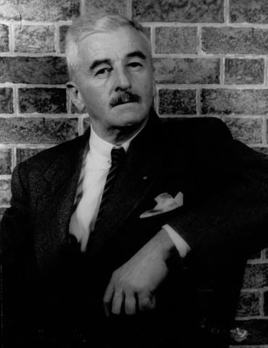
Through the perspectives of multiple characters, Faulkner creates a text that explores the ties between family members and the long-standing tensions that pull apart families. Although the Compson family is ostensibly the center of the novel, it’s also a novel of individuals – characters isolated even from those who know them best

Slide 12

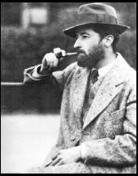
The Sound and the Fury Theme of Guilt and Blame
Your crummy fate is always easier to take if you blame it on someone else, right? Well, if you agree, this book’s for you. We’ve counted so many different layers and permutations of blame in The Sound and the Fury that, well, we’ve lost count. There’s the guilt of being a virgin and the guilt of not being a virgin.

Slide 13

There’s the shame of staying at home and the guilt involved in leaving. In other words, there are no easy choices. So racked by fear of themselves that they can’t begin to see what they might really want, characters in this text cast around for someone – anyone –to blame for their problems.

Slide 14
The Sound and the Fury Theme of Memory and the Past.
For the characters in The Sound and the Fury, memories of the past dominate the present day. Revolving around Caddy, the runaway daughter of the family, the novel works (and re-works and re-works) the consequences of her disappearance from her brothers’ lives. Everything important happened Before.

Slide 15

هناء الجحدلي
هند الغامدي
ليلى السلمي
نجاح القرني
نورة الشهري
نوف العتيبي

